Slide 1
FINAL CAPSTONE PROJECT PRESENTATION
Kenya Maize Advisory Chatbot
Final Capstone Project · Local PDF search and answers in English and Swahili
By: Willard Owiti

Slide 2
1 · PROBLEM STATEMENT & OBJECTIVES
Problem Statement
Advice is scattered
A language gap
Maize guidance sits inside 24 PDFs on seed, fertiliser, pests, policy and storage. A farmer cannot search 1,770 PDF pages quickly.
The PDFs are English-only. Many farmers ask in Swahili, so the evidence is locked behind a language barrier.
Chatbots can guess
Our answer
A general chatbot can invent a dose, price or date and never shows where the claim came from.
Retrieve the right page first, then write an answer that cites it. Refuse when the sources do not support an answer.
NB: RAG = Retrieval-Augmented Generation: search the evidence first, then generate. This deck covers the advisory chatbot stream; the companion YOLO classifier is reported separately.

Slide 3
1 · PROBLEM STATEMENT & OBJECTIVES
Objectives, Questions and Target
General objective
Specific objectives
Build a free, local, bilingual advisory assistant that turns static maize PDFs into grounded, cited answers for smallholder farmers.
Build a 24-PDF + 4 seed-doc corpus; retrieve the right page; generate cited answers; refuse unsafe or off-topic questions; deploy in Streamlit + MySQL.
Research questions
Target variable
Does hybrid retrieval beat dense or BM25 alone? Does the Swahili pivot help? Do tuning and guardrails improve groundedness? Is a 1.5B local generator good enough?
Two targets: (i) a relevant chunk in the top 5 (Hit@5, MRR); (ii) a grounded, cited answer that passes 13 checks (pass rate).
NB: Not a forecasting or classification study: there is no time-series or confusion matrix. The target is answer text plus retrieval relevance, scored separately.

Slide 4
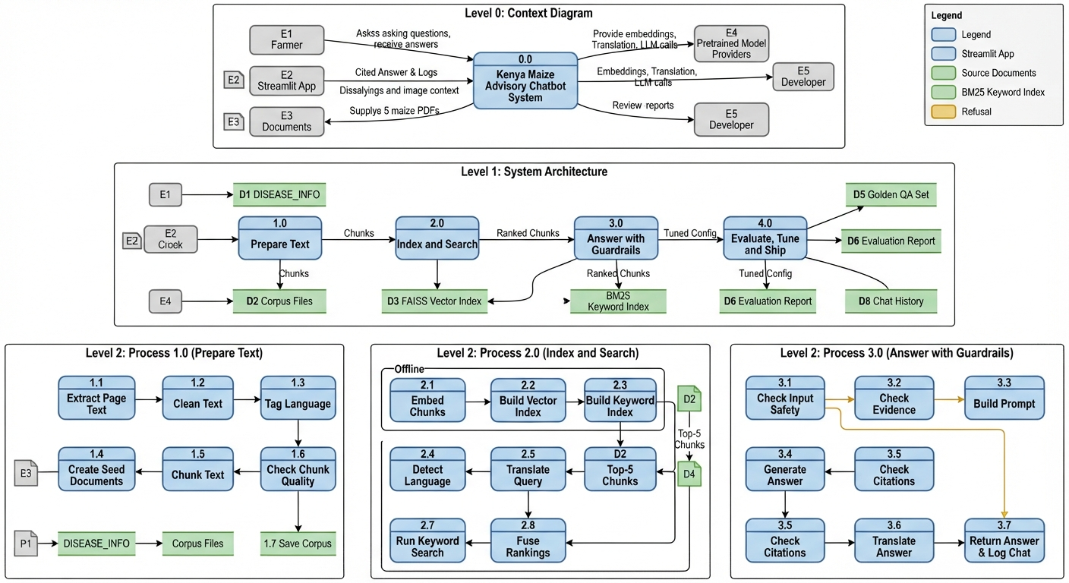
SOLUTION OVERVIEW
A Free, Local Tech Stack
No API keys
Runs on a normal CPU, free, with no outside hosting or paid API. This matters where connectivity and budgets are limited.
Two language models
NLLB-200 translates Swahili ↔ English. Qwen2.5-1.5B-Instruct writes the answer from retrieved evidence.
Python tools
PyMuPDF reads PDFs; pandas builds audit tables; sentence-transformers makes embeddings; rank_bm25 searches keywords.
Where things are saved
rag_data/ for corpus, rag_artifacts/ for index and metrics, MySQL for farmer profiles and chat history.
NB: An embedding is a list of 384 numbers that captures meaning. BM25 is keyword search that rewards exact matches. Both run locally.

Slide 5
6 · MODELLING APPROACH
The Two Language Models
THE TRANSLATOR
THE WRITER
NLLB-200 (distilled 600M)
Qwen2.5-1.5B-Instruct
Turns Swahili questions into English so the English corpus can be searched, then turns the English answer back into Swahili. 200 languages, 600M parameters, local.
Reads the top-5 retrieved chunks and writes a cited answer. Instruction-tuned, 1.5B parameters, CPU-friendly, greedy decoding by default.
NB: Both are small, open, pretrained models. The farm knowledge comes from retrieved PDFs, not from model weights—this is what keeps answers grounded.

Slide 6
METHOD & REPRODUCIBILITY
Setup and Settings
Repeatable results
Seed 42 fixes Python, NumPy and Torch randomness. The same 12 retrieval questions and 13 answer probes are reused across runs, and evaluation sets are fixed before tuning.
Chunk size
Steady answers
220 words per chunk, 40-word overlap, 30-word minimum. Fits the embedding window while keeping citations on one page.
Temperature 0.0 (greedy), top-p 0.9 only if sampling, max 400 new tokens. Same question → same grounded answer.
NB: Settings are not arbitrary: chunk size, top-k and temperature were re-checked in the notebook’s Sections 7 and 11.

Slide 7
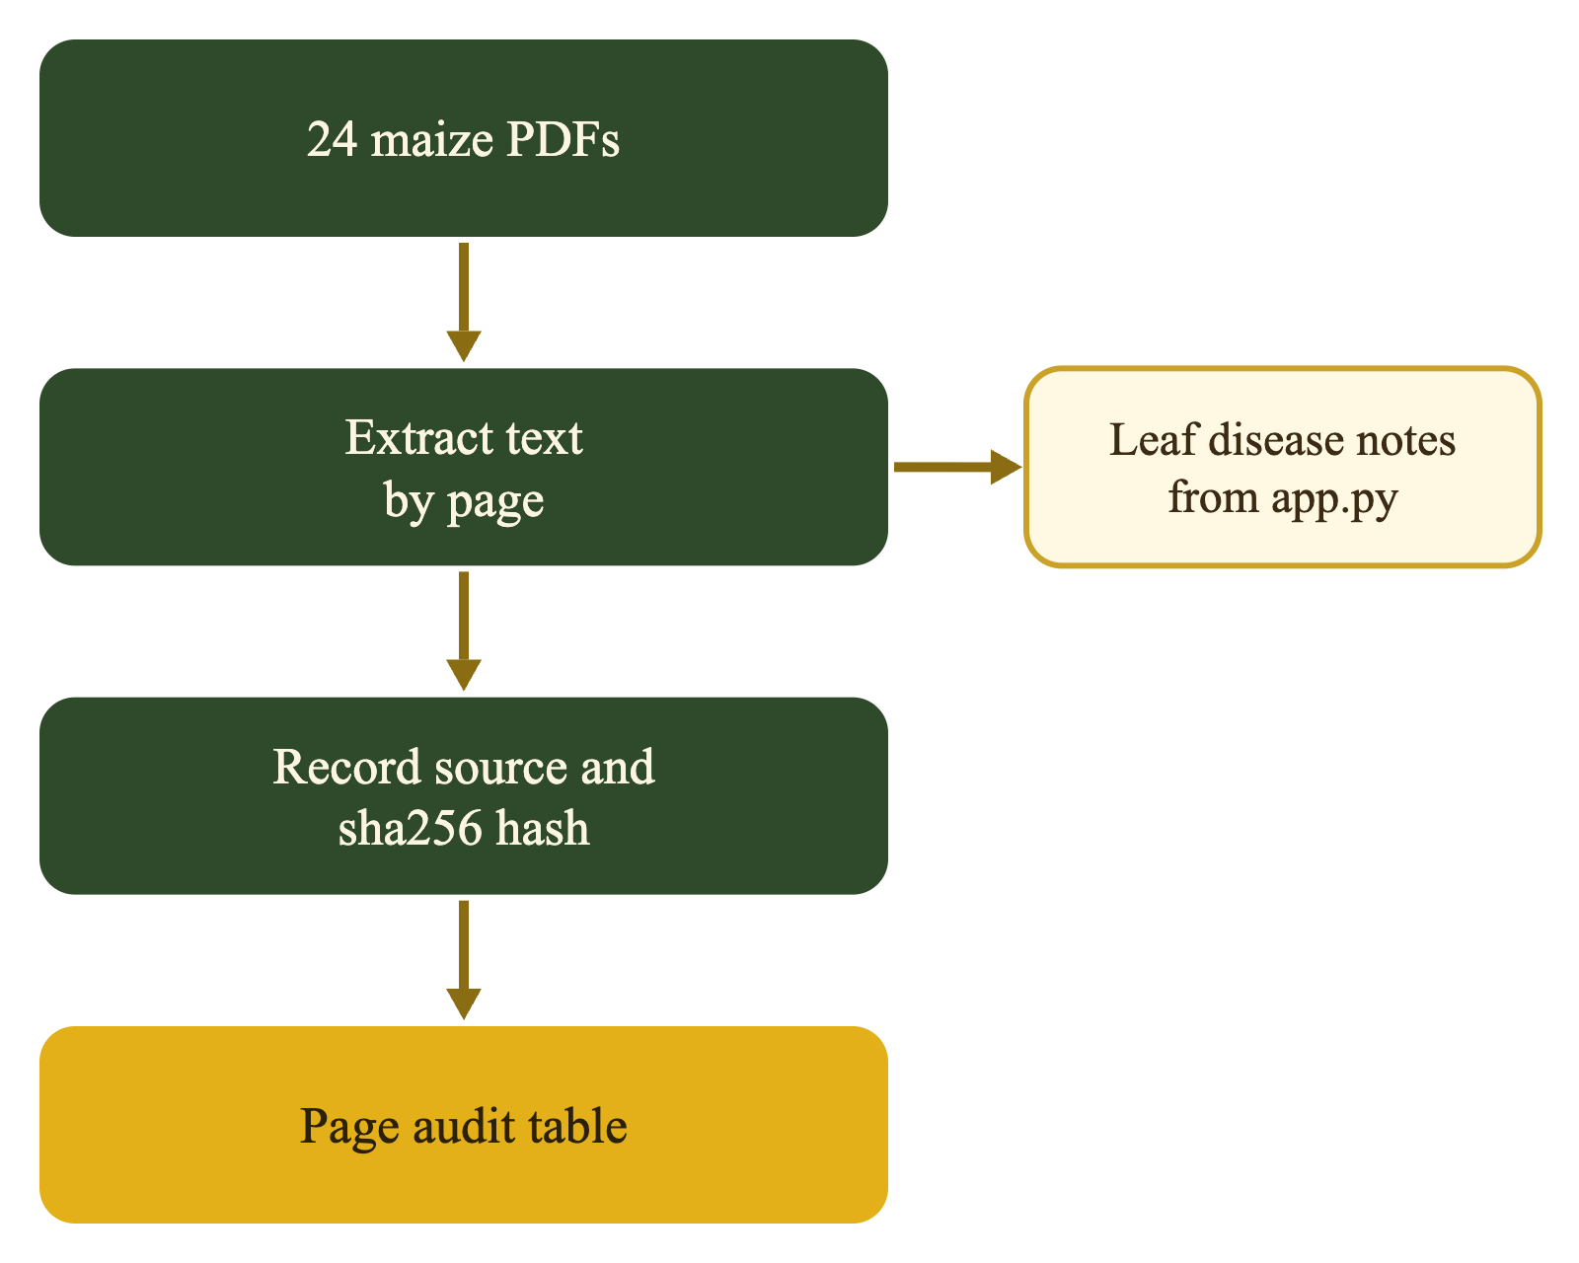
2 · DATASET OVERVIEW
Dataset Overview
Source and size. 24 maize PDFs + 4 seed docs: 1,774 pages, 3,447 chunks, 570,677 words. KALRO, CIMMYT, FAO, IFDC, KEPHIS, NCPB, MoA.
Features. source_id, page, topic, language, n_words, text and SHA-256. 220-word chunks never cross a page, so citations stay exact.
Target and provenance. Retrieve relevant evidence for a question and generate a cited answer. source_manifest.json and page_audit.csv track every page.

Slide 8
2 · DATASET OVERVIEW
Dataset Profile and Limitations
Size and composition
Features and types
28 documents → 1,774 pages → 3,447 chunks → 570,677 words. Nine topics; agronomy (888 chunks) and policy (661) dominate.
text (string), source_id/page (categorical/int), topic/language (categorical), n_words (int), SHA-256 (ID). No numeric feature matrix; embeddings are learned from text.
Target definition
Limitations
Retrieval target: binary relevance of each question–chunk pair, labelled by chunk ID. Answer target: groundedness, citation, language and safety, scored by 13 probes.
English-only corpus; 28 blank scans; fertiliser only 23 chunks; static 2014–2025 policy; no live prices; tables degrade to text; no OCR.
NB: The 24 PDFs and 4 DISEASE_INFO seed docs were merged at chunk level with source_id; no row-level join was needed.

Slide 9
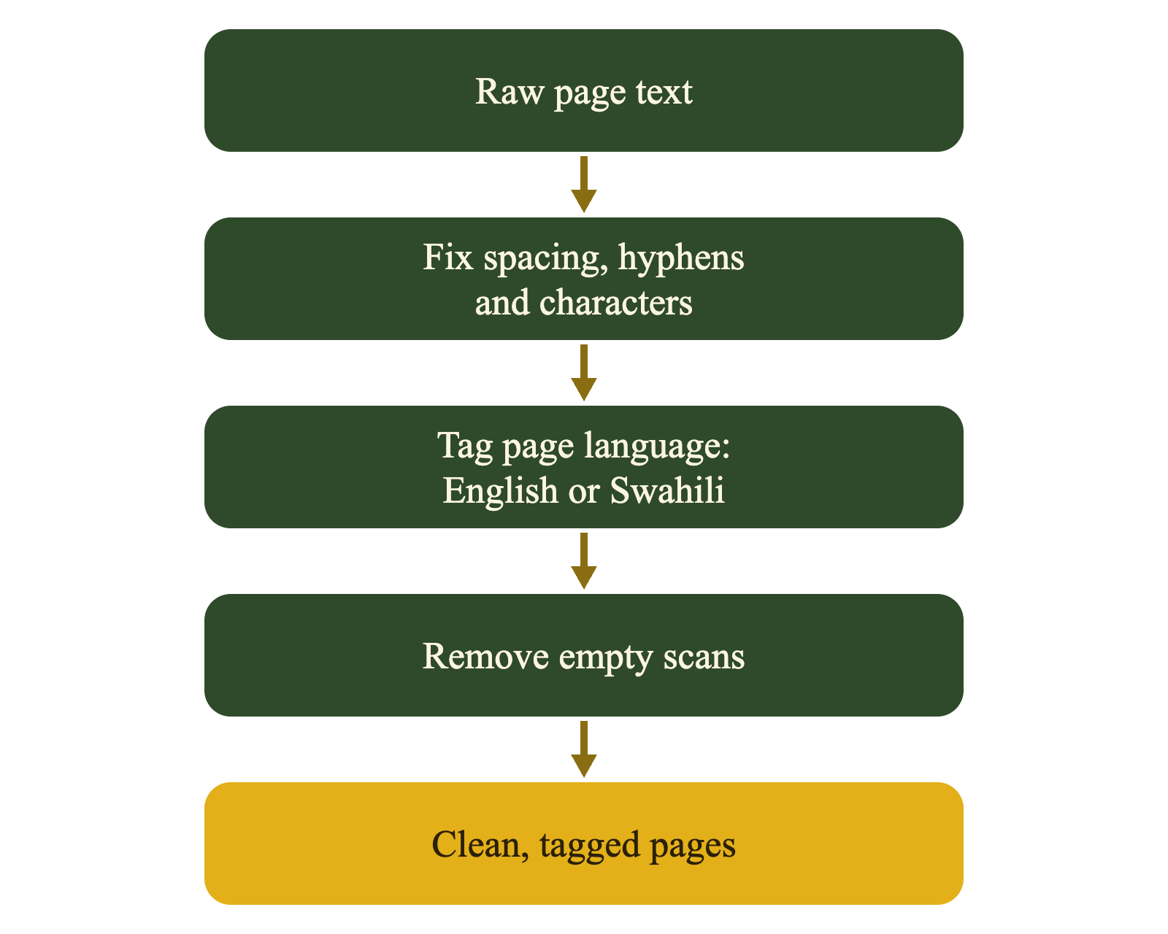
3 · DATA CLEANING & PREPROCESSING
Cleaning and Language Tagging
Tidy text. NFC normalization; remove nulls and non-breaking spaces; rejoin hyphenated line breaks; collapse whitespace. No stemming or stopword removal.
Page by page. Each page stays separate so citations point to the exact page. 28 blank pages removed; no text imputed.
Language tagging. Stopword counts label 1,521 pages English, 253 unknown, 0 Swahili. Unknown is treated as English.

Slide 10
3 · DATA CLEANING & PREPROCESSING
Data Quality, Encoding and Leakage
Missing values
Duplicates and outliers
28 blank pages (1.6%) removed; 161 tiny chunks (<30 words) reviewed and kept, so short source pages are not lost. No imputation: a fabricated sentence would be retrieved as evidence.
1 exact duplicate chunk removed; 3,447 unique text hashes remain. 2 duplicate “Thank You” pages. Chunk length capped at 220 words; 190 short pages reviewed, not silently deleted.
Encoding and scaling
Leakage control
Text is not one-hot/label encoded. e5 embeddings are the representation, L2-normalized to length 1 so dot product = cosine. BM25 uses lowercase tokens; no numeric scaling needed.
No model is fitted on evaluation labels. Questions are fixed before tuning; tuning and final scoring use the same 12 questions, so scores are optimistic—acknowledged as a limitation.
NB: No train/test split for the embedder or generator: both are pretrained and used zero-shot. The held-out idea applies to evaluation questions, not model fitting.

Slide 11
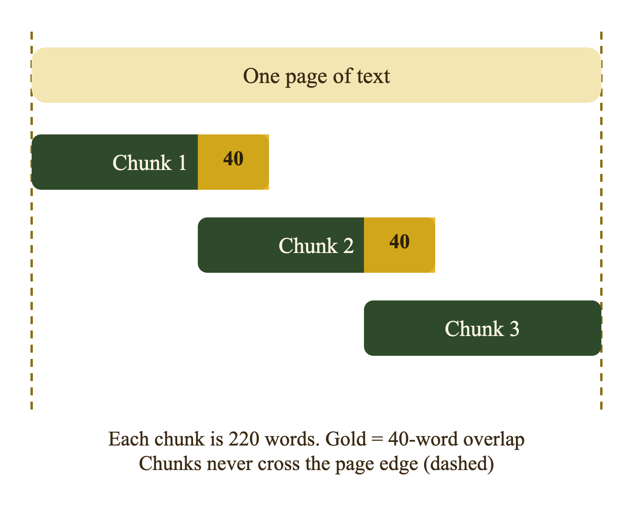
3 · FEATURE ENGINEERING
Chunking and Feature Engineering
Small pieces. 220-word chunks, 40-word overlap, 30-word minimum; chunks never cross a page.
No duplicates. text_sha256 drops repeated text; 3,447 unique chunks remain.
Easy to trace. IDs like S02-p0004-c001 map every citation back to source and page; 220 words fits e5’s input limit.

Slide 12
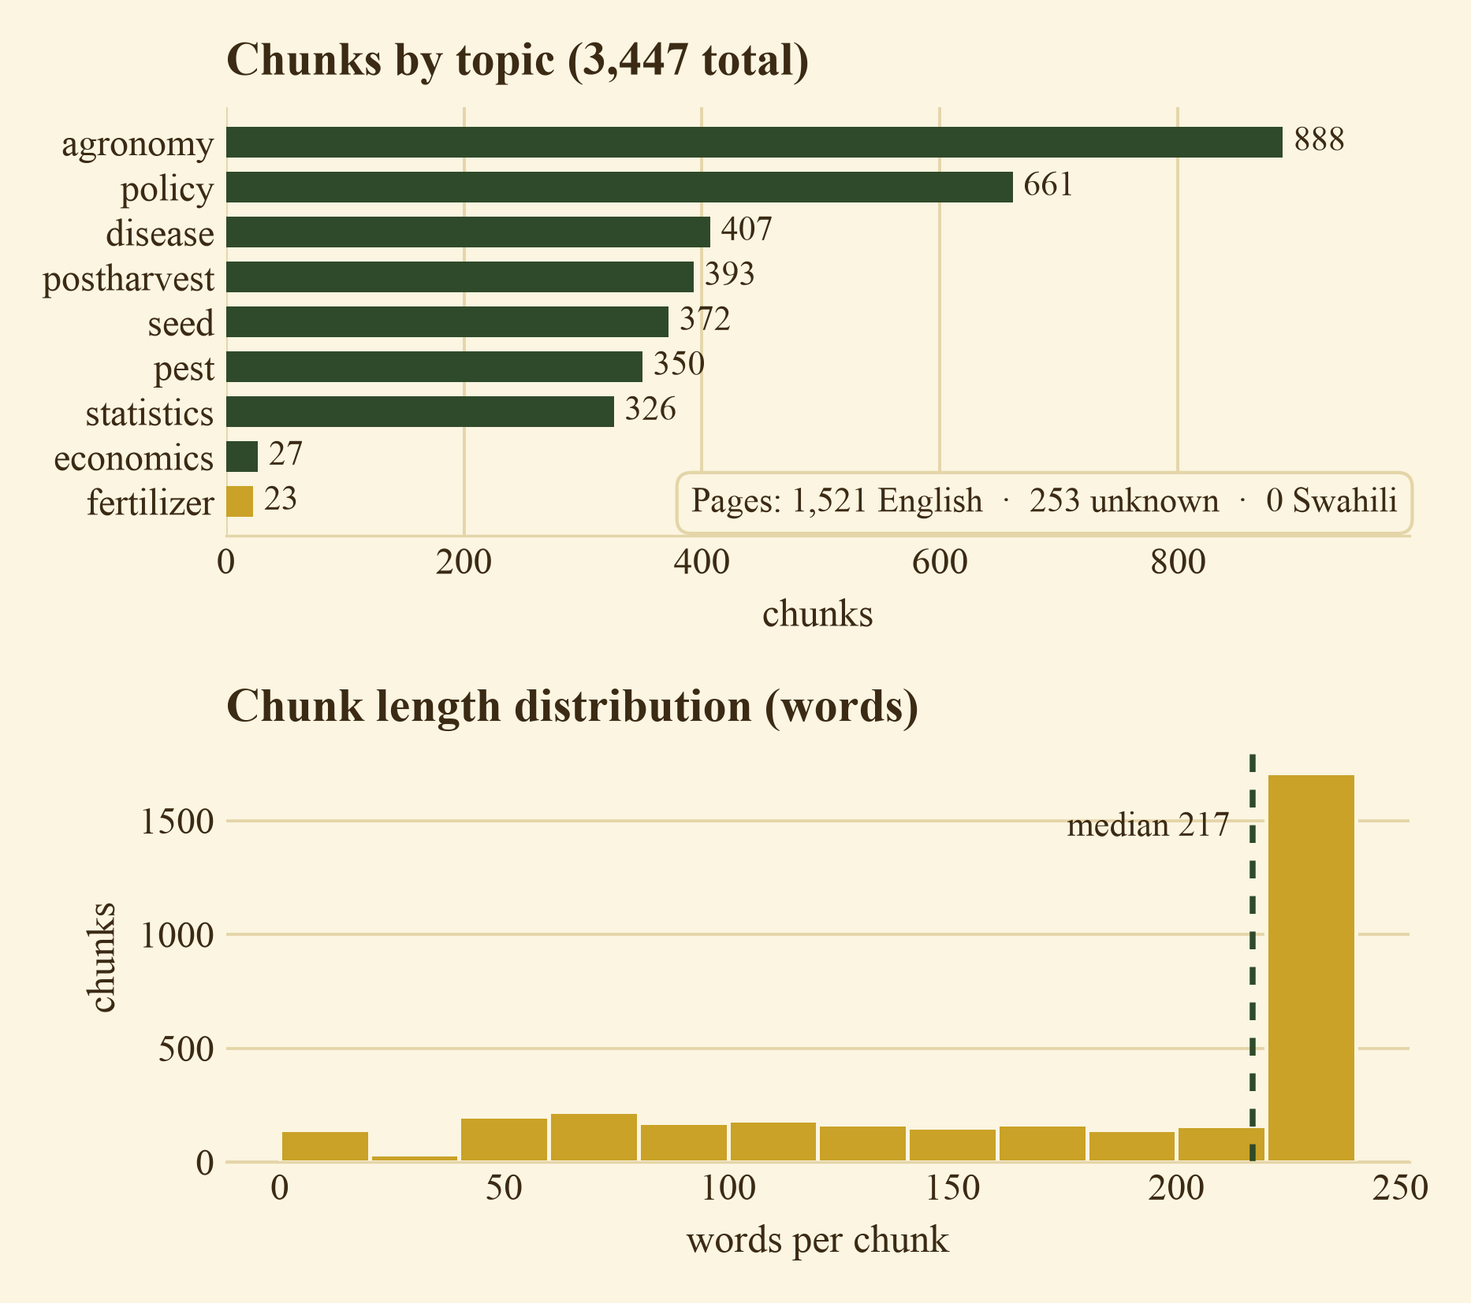
4 · EXPLORATORY DATA ANALYSIS
What the Corpus Tells Us
Topic imbalance. Agronomy 888 chunks (25.8%) and policy 661 (19.2%) dominate; fertiliser has only 23 (0.7%).
Language and length. 1,521 English pages, 253 unknown, 0 Swahili. Median chunk 217 words; 161 chunks are under 30 words.
Concentration and decision. S10 + S24 + S09 = 47% of chunks. Keep all topics, but test fertiliser, price and Swahili questions separately.
NB: EDA is descriptive: it tells us what the retriever can find, not whether the answer is correct. That is measured in Section 7.

Slide 13
6 · MODELLING APPROACH
Models Considered and Why
Component | How it works | Why suitable | Key limitation
Dense retrieval | Embed question and chunks; cosine top-k. | Semantic and cross-lingual, local and cheap. | Misses exact names/numbers; English corpus.
BM25 keyword | Token overlap with IDF; exact matching. | Strong on DAP, CAN and variety codes. | No meaning or Swahili matching.
Hybrid RRF | Fuses dense and BM25 ranks, not raw scores. | Combines both strengths; tunable. | Needs tuning; can dilute a strong list.
NLLB-200 | Seq2seq translation Swahili ↔ English. | 200 languages, local, no API. | Translation errors propagate; latency.
Qwen2.5-1.5B | Instruction-tuned LLM writes from top-5 chunks. | CPU-friendly; follows citation prompt. | Can omit citations or add detail.
Baseline | Dense-only top-5, no fusion or tuning. | Simple reference to beat. | Misses 4/12 questions; no keyword help.
All models are pretrained and used zero-shot; we compare retrieval methods and generation settings, not train a new model from scratch.

Slide 14
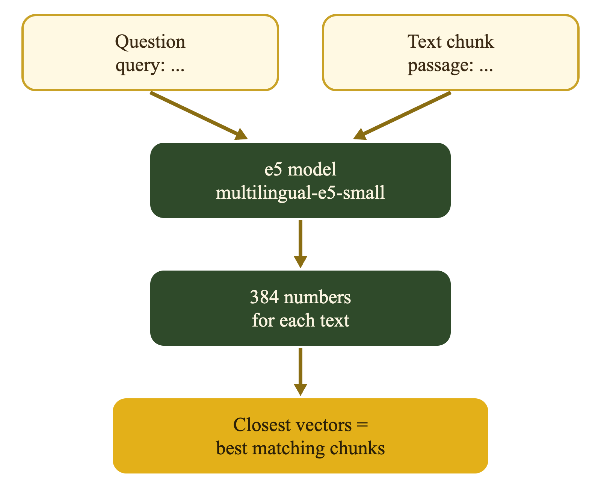
6 · MODELLING APPROACH
Embeddings and Vector Store
What it is. multilingual-e5-small turns text into 384 numbers that capture meaning; about 120 MB, local.
Multilingual. Trained on Swahili, so a Swahili question can land near English text; the corpus has 0 Swahili pages, so this is essential.
Prefixes. e5 expects “query: ” before questions and “passage: ” before documents; mixing them changes the vector.
Saved matrix. 3,447 vectors × 384 dims, L2-normalized and stored in chunks.npy; dot product = cosine similarity.

Slide 15
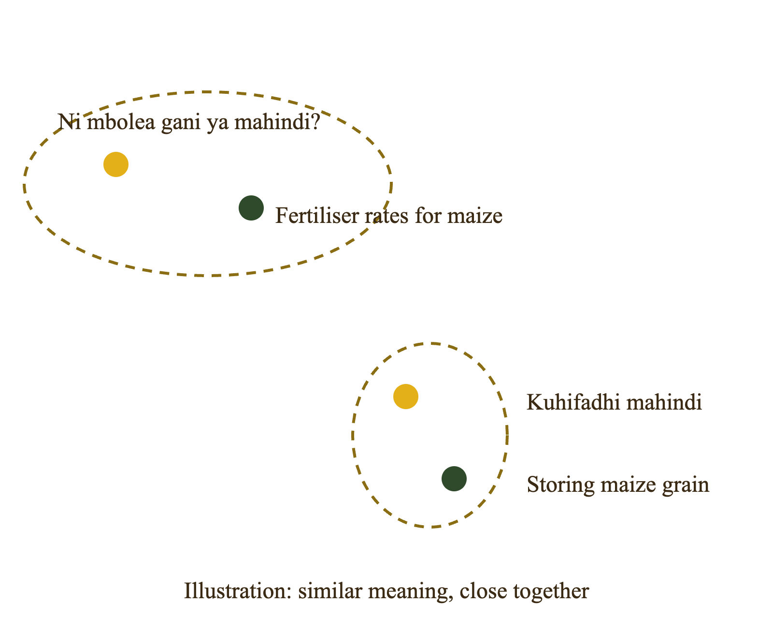
6 · MODELLING APPROACH
What Are Sentence Transformers?
A Python library. sentence_transformers loads models that turn a sentence into a vector.
Our model. intfloat/multilingual-e5-small: about 120 MB, free, local, Swahili-capable.
Why it matters. Similar meanings land close together, so a Swahili question can retrieve English text; exact numbers are left to BM25.

Slide 16
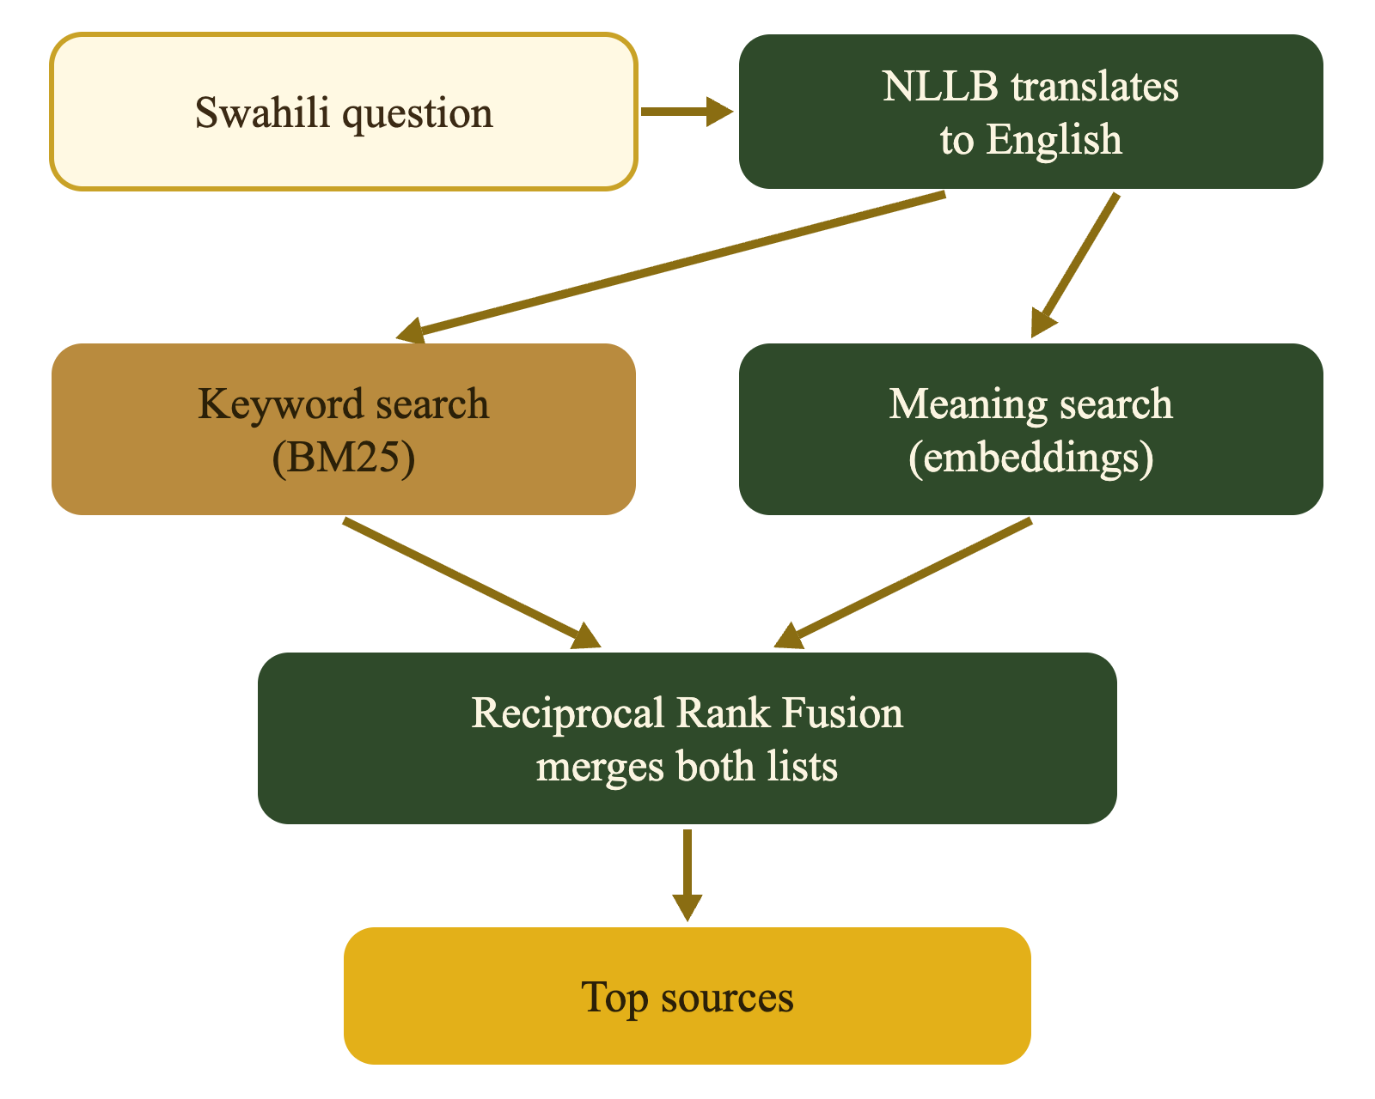
6 · MODELLING APPROACH
Search and the Swahili Pivot
Keyword search. BM25 finds exact word matches; strong on acronyms such as DAP or CAN.
Blended ranking. Reciprocal Rank Fusion merges dense and BM25 ranks because raw scores are not comparable.
Swahili pivot. looks_swahili() routes Swahili through NLLB to English, searches English sources, then translates back; retrieve() is the single interface.
NB: RRF merges two ranked result lists into one list using rank position, not raw score.

Slide 17
6 · MODELLING APPROACH
Prompt Design
Agronomist role
Stay grounded
Answer like a Kenyan extension agent: practical, specific, honest about uncertainty.
Use only the numbered sources. If the answer is absent, say so and point to a county extension officer.
Cite every fact
Safety first
Inline references such as [1] and [2] after each claim; no citation, no claim.
State pesticide product, rate and waiting period only if the source does; add handling warnings.
NB: The prompt is a constraint, not a guarantee. validate_answer() checks the output and retries once if a rule is broken.

Slide 18
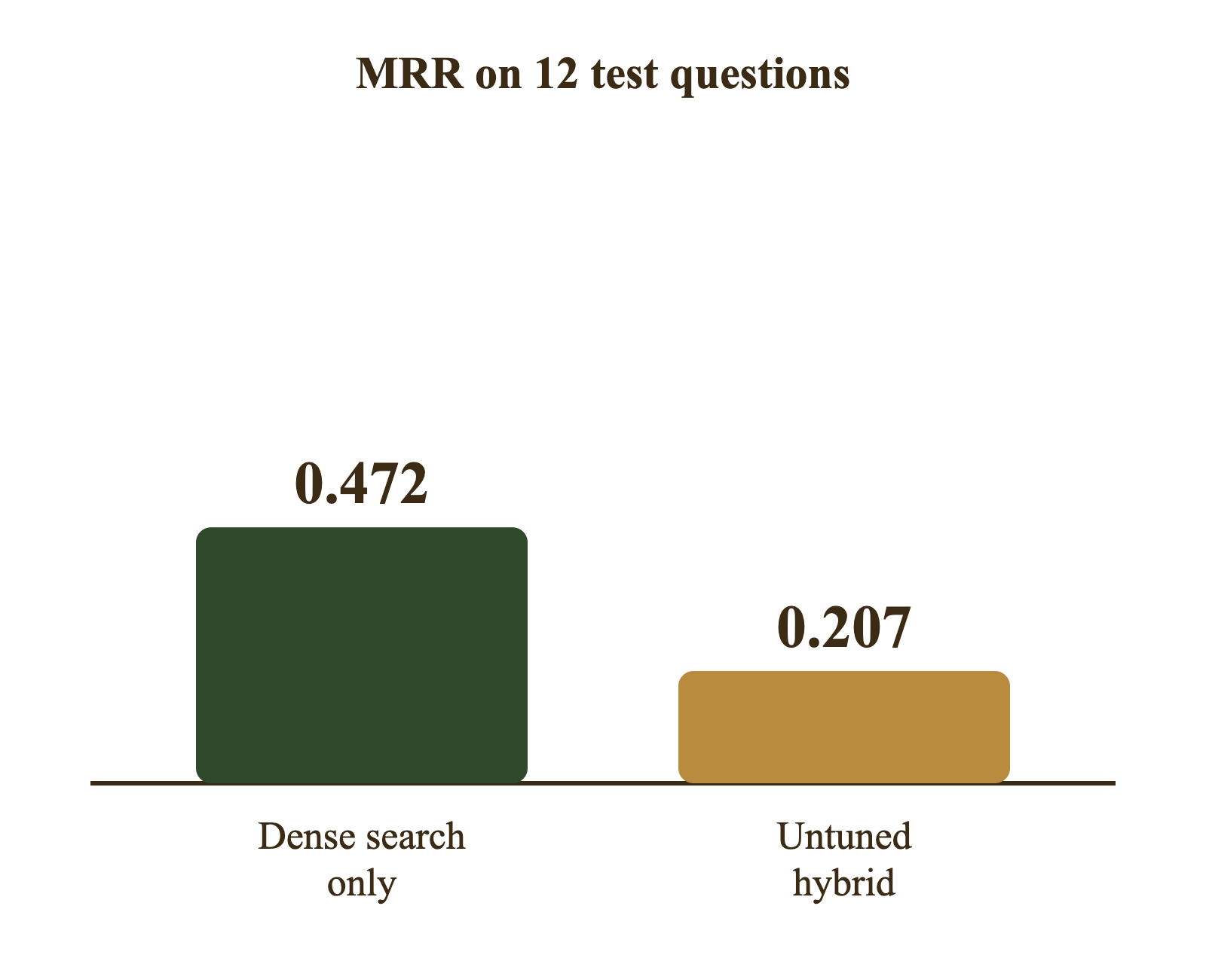
7 · MODEL PERFORMANCE EVALUATION
Evaluating Retrieval Quality
12 test questions. 8 English + 4 Swahili, keyed to exact chunk IDs.
Two metrics. Hit@5 = correct chunk in top 5; MRR = how high the first correct chunk ranks (1.0 = first).
First result. Dense: Hit@5 0.67, MRR 0.472. Untuned hybrid: 0.50, 0.207. BM25: 0.17, 0.104.
NB: Hit@5: did the right source appear in the top 5? MRR (Mean Reciprocal Rank): how high the right source ranks, where 1.0 is best.

Slide 19
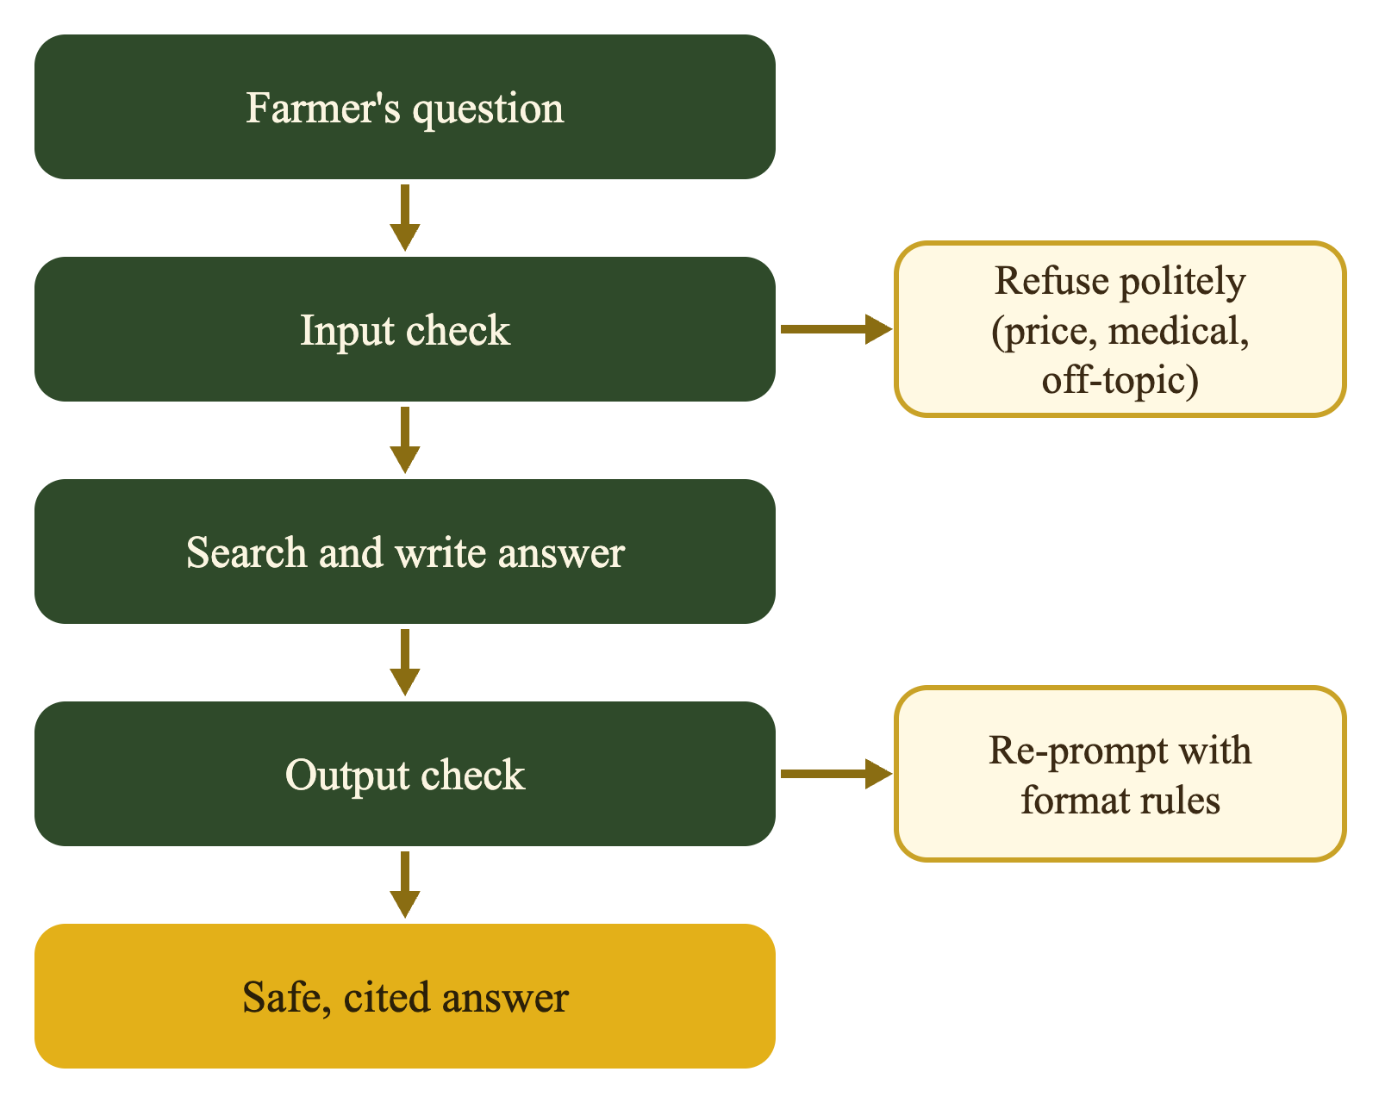
6 · MODELLING APPROACH: SAFETY
Guardrails
Block early. Price/subsidy, human medical and off-topic questions stop before search; the refusal is in the question’s language.
Scores cannot judge topic. Real and junk questions overlap at cosine 0.75–0.89, so keyword rules do the gating.
Check the answer. validate_answer() checks citation presence/range, disclaimer, language, certainty and pesticide rate; one retry then show.
NB: A guardrail is a rule that blocks or checks questions and answers for safety.

Slide 20
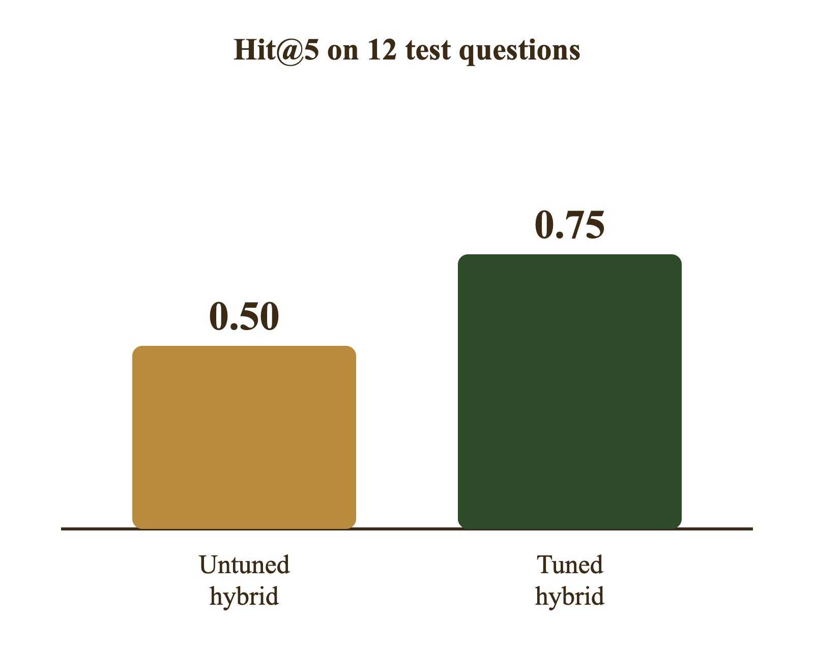
7 · HYPERPARAMETER TUNING
Tuning the Blend
84 combinations. dense_weight × depth × rrf_k, scored on the same 12 questions.
Best settings. dense_weight 0.9, depth 10, rrf_k 30: meaning search dominates, BM25 still contributes.
Better coverage. Hit@5 0.50 → 0.75, beating dense (0.67); MRR 0.422 vs dense 0.472—hybrid wins top-5 recall, dense still ranks slightly higher.
NB: How much each search counts (meaning search gets 0.9).
Search depth: how many top results from each search enter the merge (10).
Rank constant (rrf_k): how much top ranks beat lower ones (30).

Slide 21
7 · MODEL PERFORMANCE EVALUATION
All Systems Compared
System | Hit@5 | MRR | What it means
Dense baseline | 0.667 | 0.472 | Best ranker, but misses 4 of 12 questions.
BM25 only | 0.167 | 0.104 | Good for exact terms, poor overall.
Hybrid before tuning | 0.500 | 0.207 | Fusion diluted the strong dense list.
Hybrid without pivot | 0.250 | 0.128 | Swahili questions fail without translation.
Hybrid after tuning | 0.750 | 0.422 | Best coverage: 9 of 12 questions in top 5.
Read-across | — | — | 3/12 still miss; first hit usually ranks 2–3.
Selection uses Hit@5 because the generator sees the top 5; MRR shows ranking quality. Dense remains a strong, simpler baseline.

Slide 22
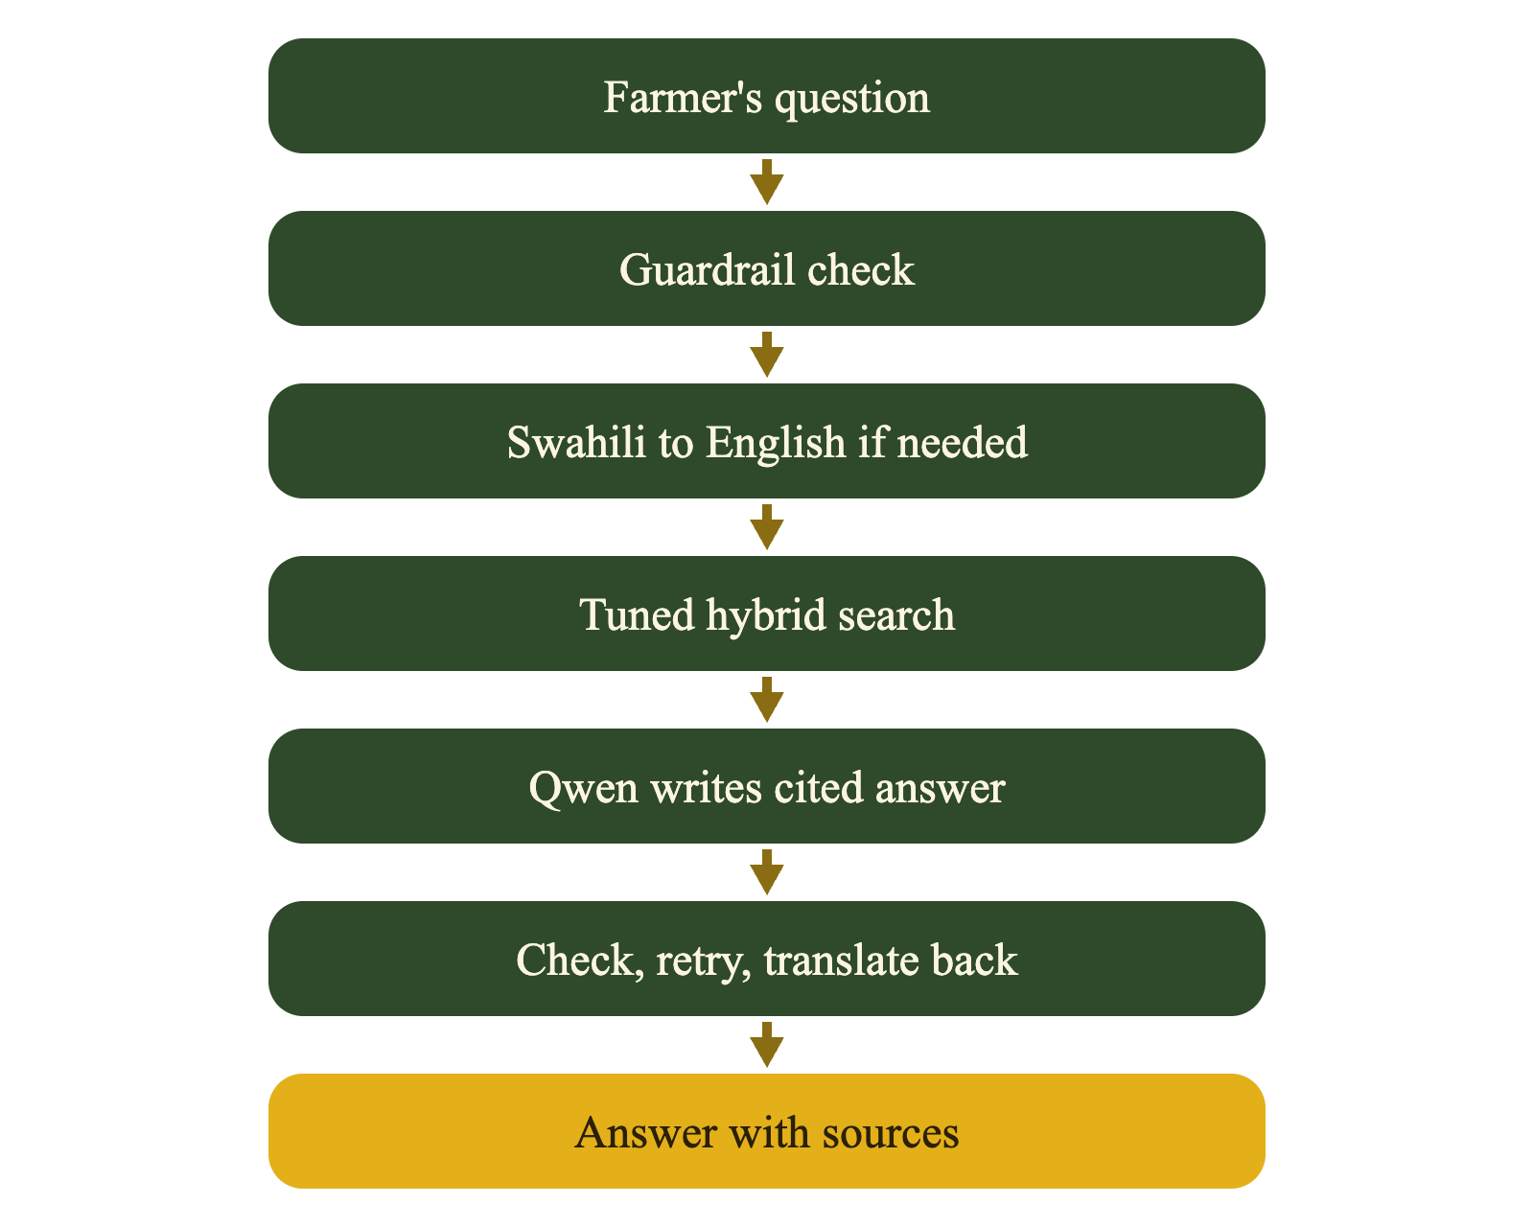
6 · FINAL MODEL
Putting It All Together
ask() runs everything. Refuse → route/translate → tuned hybrid search → prompt → Qwen → validate → retry once.
Swahili in, Swahili out. The English answer is translated back; the disclaimer is re-attached because validation checks the exact sentence.
Speed and export. Generation is slowest; search is fast. chunks.jsonl, vectors.npy and config.json are exported with a SHA-256 manifest.

Slide 23
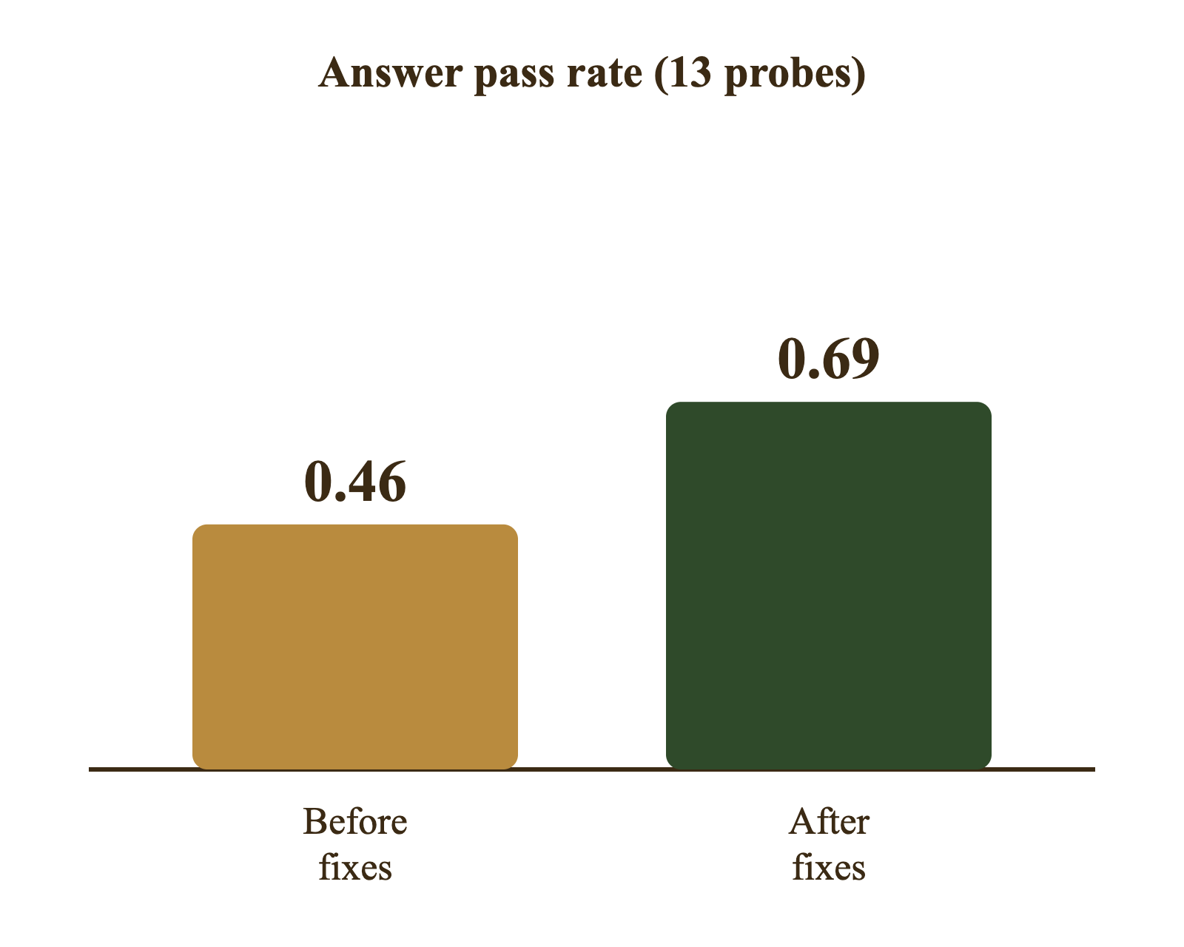
9 · ERROR ANALYSIS
Reducing Errors
13 probes. 6 answerable + 7 expected refusals: price, medical, off-topic and fabrication bait.
Five offline signals. Citations, disclaimer, language, unsupported numbers, claim support, answer–context cosine—no extra model.
Before → after. 9/13 flagged; pass rate 0.46 → 0.69. Disclaimer 5→0, numbers 1→0, refusals 3→0, pesticide 2→1, support 2→1, citation 7→4.
NB: A probe is a test question used to check answers. Pass rate is the share of the 13 probes whose answers raised no real flags.

Slide 24
9 · ERROR ANALYSIS
How the Errors Were Fixed
Problem found | Before | After | How it was fixed
Disclaimer missing | 5 | 0 | Code now adds the safety disclaimer to every answer
Unsupported numbers | 1 | 0 | Source labels such as S02 are no longer counted as numbers
Pesticide without a rate | 2 | 1 | "Rate not specified" is no longer flagged wrongly
Should have refused | 3 | 0 | "Not in the sources" becomes a standard refusal message
Weak claim support | 2 | 1 | Framing sentences are skipped in the claim check
No citation | 7 | 4 | Improved, but still the main gap
Several flags were false alarms, so the fixes improved the checker as well as the answers. Citation discipline remains the main gap: 4 of 13 answers still lack a citation.

Slide 25
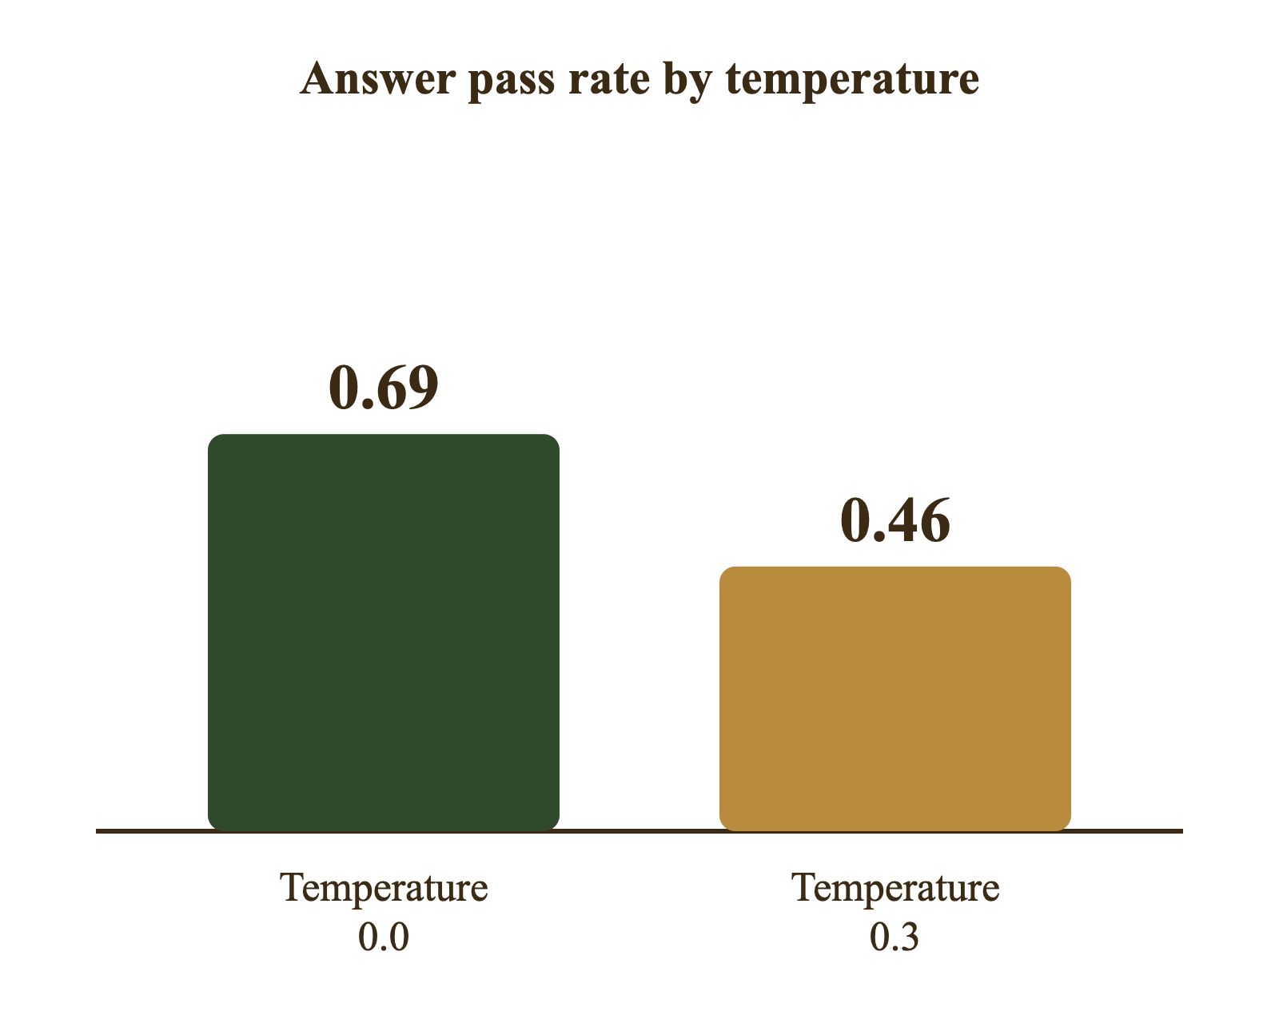
7 · HYPERPARAMETER SELECTION
Temperature
What it does. Divides next-token scores before softmax; 0.0 = greedy/most likely, higher = more random.
What we found. At 0.3: pass rate 0.69 → 0.46, real flags 4 → 7, unsupported numbers 0 → 1, citation rate 0.11 → 0.06.
Decision. Keep 0.0: no sampled temperature cleared +2/13 pass rate without worsening numbers or citations; same question gives same grounded answer.

Slide 26
9 · LEARNING CURVES, ERROR ANALYSIS & INTERPRETABILITY
Generalisation and Interpretability
No learning curves
How we checked generalisation
We do not train the embedder, translator or generator; they are pretrained and used zero-shot. There is no epoch-wise train/validation curve to plot.
12 retrieval questions + 13 answer probes + 7 guardrail cases, fixed before tuning. We report per-question misses, not only averages.
What the errors show
Interpretability
Misses concentrate on Swahili without the pivot (0/4 vs 3/4), planting time, variety popularity and county production—corpus gaps or ambiguous questions.
Retrieval is traceable: every answer carries source/chunk IDs and page numbers. We inspect the exact chunks used; no post-hoc black-box attribution is needed.
NB: Feature usefulness ≠ causation: a chunk being retrieved does not prove it caused the answer. The citation is evidence, not proof of correctness.

Slide 27
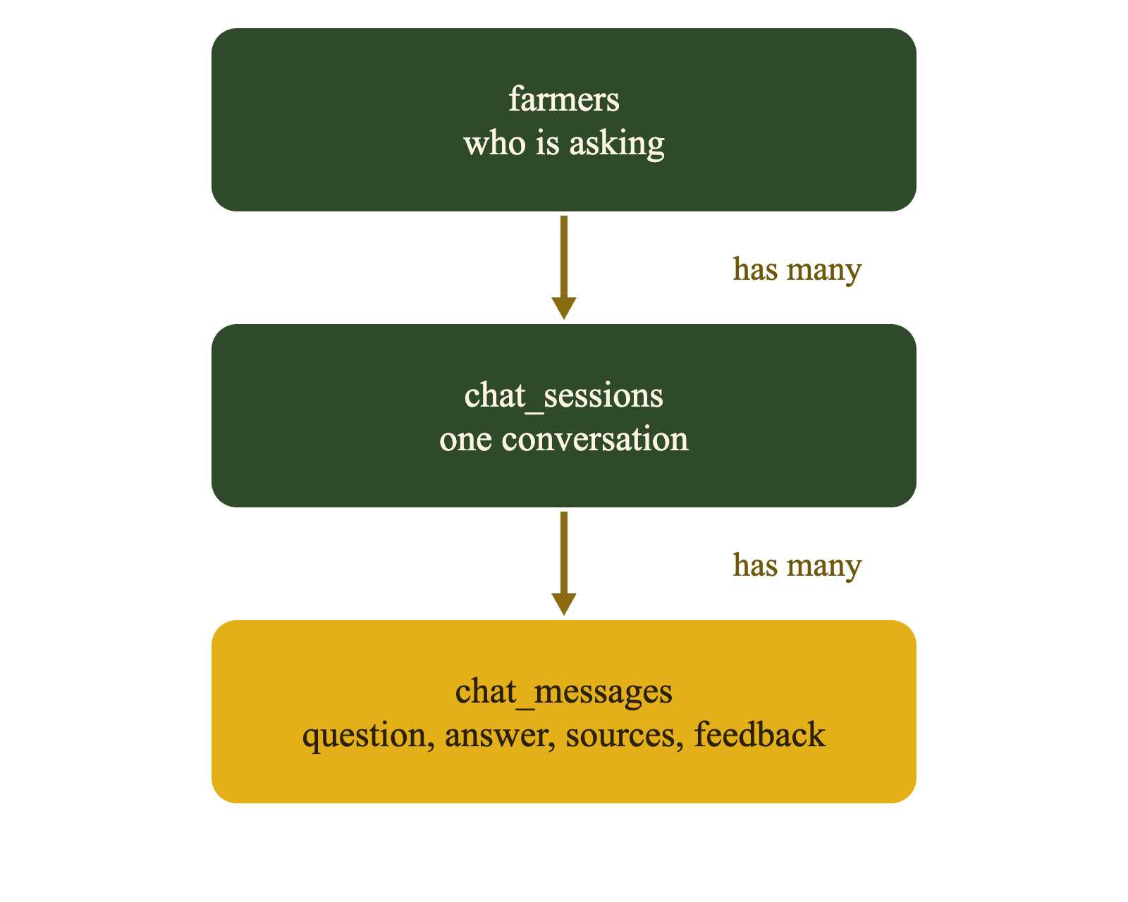
10 · PRACTICAL APPLICATION
Chat History in MySQL
Three tables. farmers → chat_sessions → chat_messages; one farmer has many conversations.
Secrets stay safe. Credentials in .env, not code; passwords stored as salted PBKDF2-HMAC-SHA256 hashes.
Full record. Question, answer, sources as JSON, language and feedback; a conversation can be reopened and continued.

Slide 28
10 · LIMITATIONS
Limitations: What This System Cannot Do
Data limits
Evaluation limits
English-only corpus, no Swahili PDFs; 28 blank scans; fertiliser only 23 chunks; static 2014–2025 documents; no live prices or weather.
Only 12 retrieval questions and 13 answer probes; the same sets were used for tuning, so scores are optimistic and confidence intervals are wide.
Model limits
Method limits
1.5B generator can omit citations or add unsupported detail; NLLB translation errors propagate; CPU-only latency is noticeable.
Keyword rules handle topic refusal, not nuance; tables and scanned pages degrade to text; no OCR; no user study with farmers.
NB: These are not hidden: they define what the system can and cannot be trusted to do. The next slide turns them into recommendations.

Slide 29
10 · RECOMMENDATIONS
Future Improvements
Swahili sources
Faster answers
Add Swahili documents and evaluate natively; today’s pivot is a workaround, not a substitute.
Generation is the bottleneck; test quantisation, smaller models, caching and batching.
Larger test set
Stronger citations
Grow beyond 12 retrieval questions and 13 answer probes; separate tuning from final test.
Citation discipline is the main remaining flag (4/13); add constrained decoding or a citation verifier.

Slide 30
10 · CONCLUSIONS
Conclusion
0.50 to 0.75
0.46 to 0.69
2 languages
Search Hit@5 after tuning the blend
Answer pass rate after the fixes
English and Swahili, free and local
Objectives achieved: a free, local, bilingual RAG assistant that retrieves evidence, cites sources and refuses what it cannot support. Retrieval coverage improved; 3/12 questions still miss and citation discipline remains the main gap.
Thank you.
Any Questions

Slide 31
APPENDIX
Glossary: Core Ideas
Term | Plain meaning
RAG | Retrieval-Augmented Generation: find sources first, then write the answer from them.
Embedding | A list of 384 numbers that captures the meaning of a text.
Chunk | A 220-word piece of a page. It is the unit we search.
BM25 | Keyword search that rewards exact word matches.
RRF | Reciprocal Rank Fusion: merges two ranked result lists into one.
Temperature | How random the model is. At 0.0 it gives the same answer every time.
Guardrail | A rule that blocks or checks questions and answers for safety.

Slide 32
APPENDIX
Glossary: Tuning and Testing
Term | Plain meaning
Blend weights | How much each search counts in the merge. Ours gives meaning search 0.9.
Search depth | How many top results from each search go into the merge (ours: 10).
Rank constant | An RRF setting (rrf_k) that controls how much top ranks beat lower ones (ours: 30).
Hit@5 | Did the right source appear in the top 5 results?
MRR | Mean Reciprocal Rank: how high the right source ranks (1.0 is best).
Probe | A test question used to check the answers.
Pass rate | The share of the 13 probes whose answers raised no real flags.

